Slide 1
DELA-NOBA in LITHUANIA
Assoc. Prof. Dr. Loreta Chodzkienė
Vilnius University
25 April 2016, Copenhagen

Slide 2
Outline
Project participants
DELA-NOBA outcomes

Slide 3
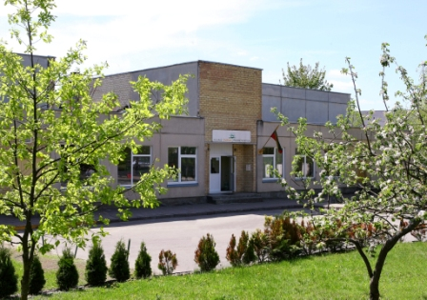
Project Participants
Vilnius Primary School “Šviesa”

Slide 4
Project Participants
Vilnius Primary School “Šviesa”
General Facts:
Established in 1993
School size 348 pupils
Class size 23 pupils
Foreign languages taught at school – English, starts to be taught at 2nd form; 2 lessons for the 2nd; 3 lessons for 3rd form; 2 lessons for the 4th form (groups split into 2 parts) per week.

Slide 5
Project tasks completed:
Project participants (n=39) – 2nd-4th formers (8-11year-olders)
1. The Turnip
2. Kitchen Detective
3. Onomatopoeia
4. Plurilingual Winter Traditions (created by Lina & Vaida)
5. Micro Respublics
6. Cartoon Strips
7. Language autobiography (background for the
research)
Pre-project and Post-project surveys
Concept of Linguistic Encounters

Slide 6
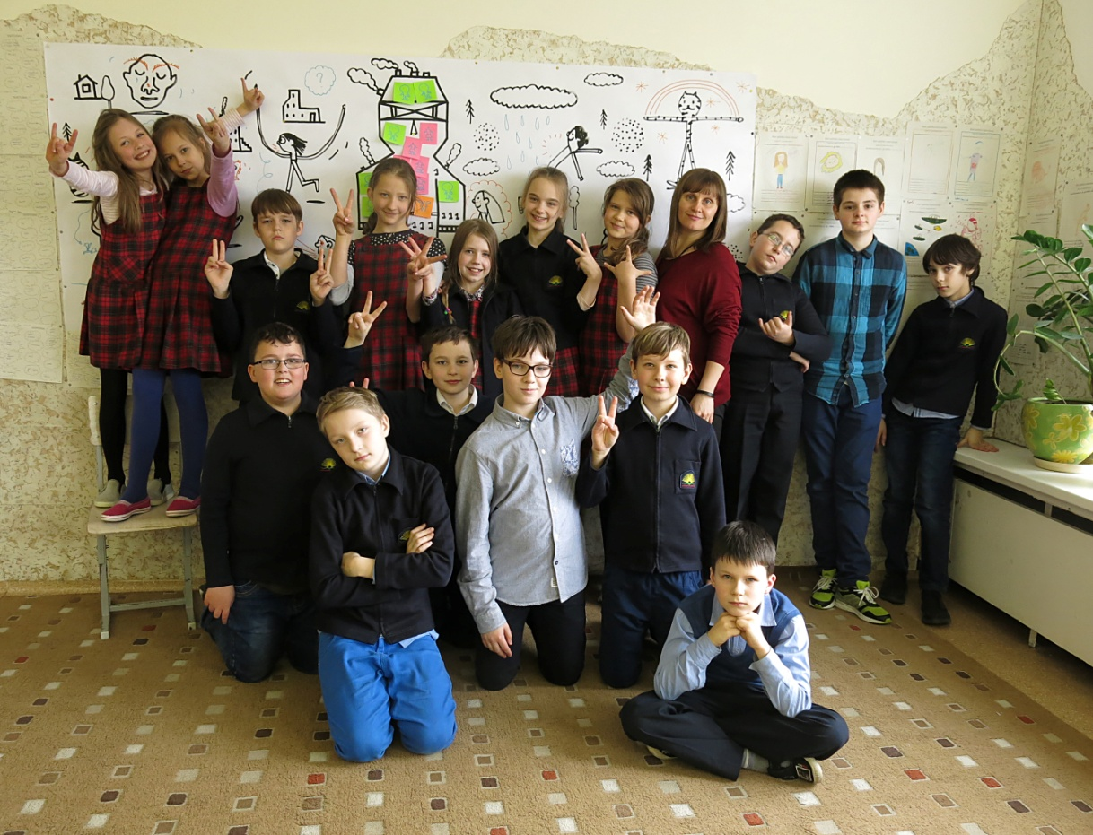
Project Participants
Teacher Vaida & her class

Slide 7
Linguistic repertoires of the 4th formers (n=18)

Slide 8
Contribution of the Project
No. | Languages encountered by the Pupils | No of Pupils
1. | Swedish | 2
2. | Czech | 2
3. | Greek | 2
4. | Bulgarian | 2
5. | Chinese | 2
6. | Islandic | 2
7. | Estonian | 1
8. | Dutch | 1
9. | Indonesian | 1
10. | Norwegian | 1
11. | Serbian | 1

Slide 9
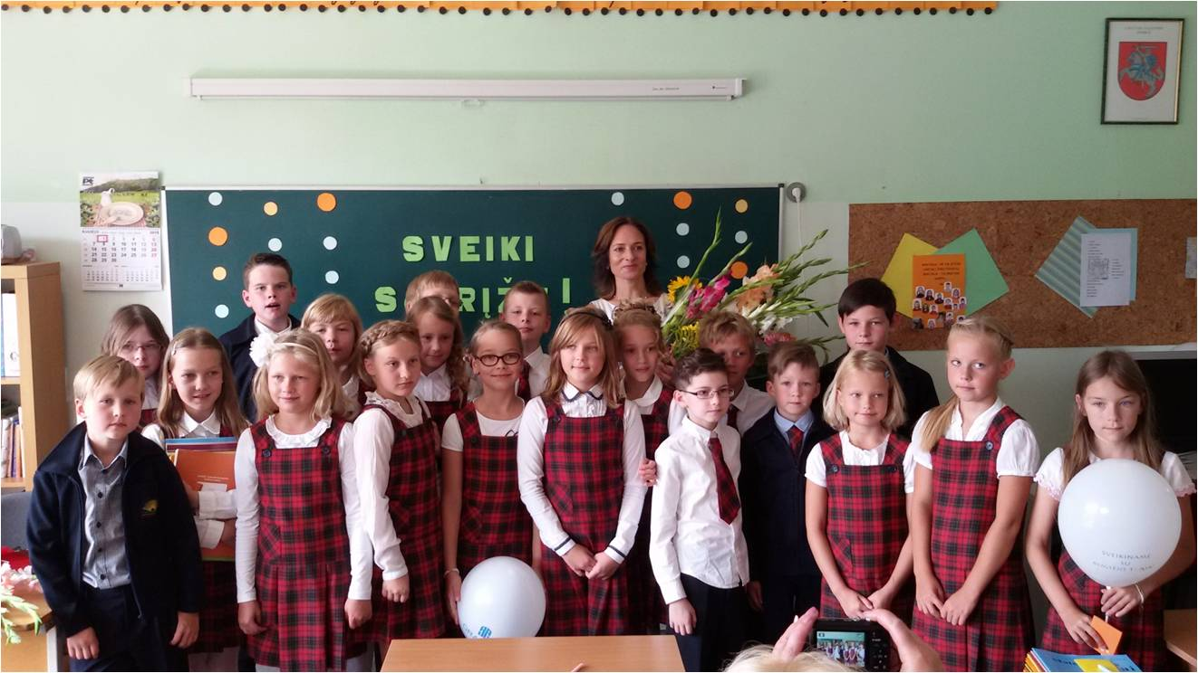
Project Participants
Teacher Lina & her class

Slide 10
Linguistic repertoires of the 4th formers (n=21)

Slide 11
Contribution of the Project
No. | Languages encountered by the Pupils | No of Pupils
1. | Finnish | 4
2. | Estonian | 3
3. | Indonesian | 3
4. | Croatian | 2
5. | Portuguese | 2
6. | Latin | 1
7. | Norwegian | 1
8. | Swedish | 1
9. | Greek | 1
10. | Danish | 1
11. | Slovakian | 1
12. | Slovenian | 1

Slide 12
Post Project survey
What is a language for the 4th former?
Words that we employ in speech
help us communicate (with friends/ other people)
help us understand each other
help us see the dreams, read and write
of the country
Sounds, words, sentences and ideas
A means of communication
Something that helps us speak with, watch films, think.

Slide 13
Post Project survey
Linguistic background of the family
1st sample group
1/3 of the families – bilingual families
Extended family members use Russian, Polish, Ukrainian
2nd sample group
Nearly all come from monolingual families (1 Russian & 1 Polish speaking grandparents)

Slide 14
Post Project survey
Why do need to learn languages?
To speak/understand with people from other countries;
To get acquainted with people from other countries;
To watch films in the original language;
For travelling;
To have holidays of “good quality”;
To get a proper job;
To discover new countries;
To read; to write.

Slide 15
Post Project survey
What foreign languages would you like to learn? Why?
Language | Why?
English | The language of the world
Russian | Many people speak it / interesting letters and words
German | It is popular and beautiful/ I’d like to live in Germany
French | V. Beautiful language, I’d like to live in France
Danish | Relate their future to the country
Swedish | Relate their future to the country
Norwegian | Relate their future to the country
Italian/Spanish | Nice countries to spend holidays / beautiful languages
Arabian | Like the country/ would like to visit it
Japanese | Like the country/ would like to visit it
Chinese | Language of the future/ easy to find a job

Slide 16
Post Project survey
DELA-NOBA project. What did it teach you?
New words of other languages;
Some facts about other countries;
Different languages have similar words;
Widened my world view;
To work in groups/ teamwork.

Slide 17
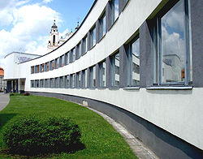
Project Participants
Vilnius S. Nėris Gymnasium

Slide 18
Project Participants
Vilnius S. Nėris Gymnasium
General Facts:
Established in 1915
School size 473 pupils
Class size (average) ~18
Foreign languages taught at school – English (1st); German, Russian, French (2nd); Italian & Japanese (optional).
English is taught 4 times per week.
Aiming at B2 (mainly) or B1.

Slide 19
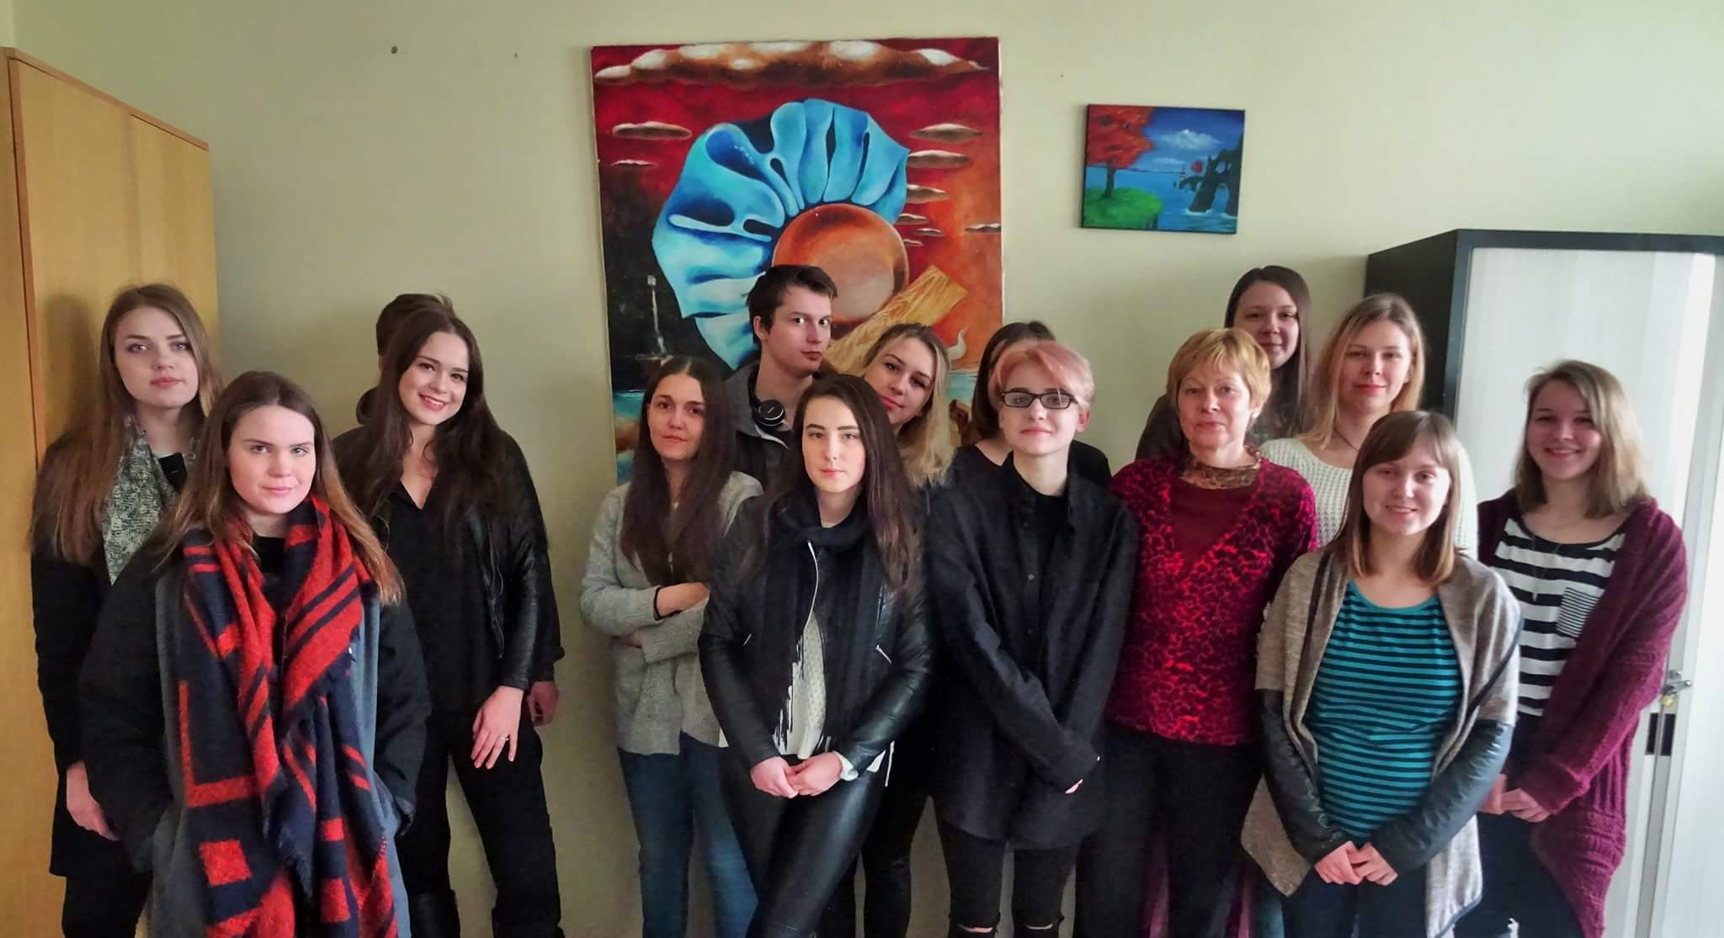
Project Participants
Teacher Jolanta & her class

Slide 20
Project tasks completed:
Project participants (n=43; n=20) – 2nd-3^{rd -}4th formers (15-19year-olders)
Signs of Zodiac
Translation: Lithuanian-English-Russian-German-French-Swedish;
Essay: Čiurlionis & his counterparts in other countries;
Presentations/ Discussions On Similarities and Differences of the Character features of Zodiac signs in different nationalities;
Creative element in interpretation of Zodiac signs (poems; paintings; miniatures).

Slide 21
Project tasks completed:
Project participants (n=43; n=20) – 2nd-3^{rd -}4th formers (15-19year-olders)
Latin vs. Modern languages
Latin gave rise to many languages.
Equivalents of Latin in:
English, German, French, Lithuanian, Danish.

Slide 22
Linguistic repertoires of the 3rd formers (2015 n= 43 / 2016 n = 20)

Slide 23
Contribution of the Project

Slide 24
DELA-NOBA
Thank you All for cooperation!

